Slide 1
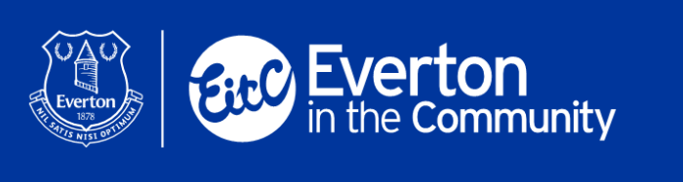
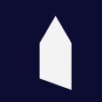
EitC Inclusive Schools Programme
SEND PE Curriculum

Slide 2
Our Purpose
To provide a high-quality PE curriculum that inspires all pupils to succeed, excel, and continually develop in sport and other physically demanding activities.
To provide opportunities for pupils to become physically confident, underpinning the development of their physical literacy, gross motor skills, fine motor skills and to improve their health and fitness.
To provide opportunities for pupils to compete in sport. To support the development of social skills, emotional wellbeing and mental health.

Slide 3

Our Aims:
Develop gross and fine motor skills, and overall physical literacy
Provide a broad range of sport and physical activities for children with SEND to experience
Create more competitive sporting opportunities for children with SEND
Promote healthy and active lifestyles
Support SEMH needs of children with SEND,
through physical activity

Slide 4
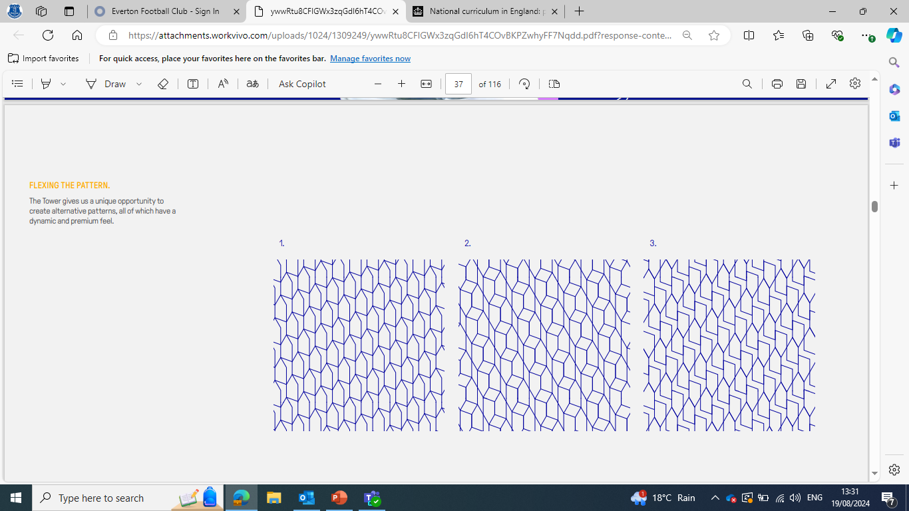

Attainment Targets:
PMLD
Pre-Formal
Semi-Formal
Formal
Show enjoyment and engagement while experiencing activities
Engage and complete individual activities with support from staff.
Participate in group activities, understanding simple rules e.g., taking turns, knowledge of some different sports
Participate in team games, understanding simple tactics including awareness of attacking and defending. Display a knowledge of different sports and rules of games.
Demonstrate communication through engagement with staff or other pupils while completing activities
Demonstrate and develop communication skills through engagement with staff and other pupils
Use effective communication skills with staff and other pupils during activities. Recognise emotions during participation.
Use effective communication skills to help complete activities. Show ability to use problem solving skills during activities. Display awareness of social and emotional skills e.g. resilience, determination and self control
React and respond to sensory cues during activities
Begin to develop fundamental movement skills e.g. run, jump, hop skip
Establish fundamental movement skills and begin to develop fine motor skills. Display some balance, coordination and agility while completing activities
Master fundamental movement skills and display good fine motor skills to complete activities. Demonstrate good balance, coordination and agility across a range of activities. Show an ability to link movements together to perform simple movement patterns e.g. dance or triple jump

Slide 5
Attainment Targets:
Key Stage 3 & 4
Post 16
Sports Leaders
Understand and use a range of tactics and strategies to overcome opponents during team and individual games. Deliberate and agree on team tactics during group activities
Recognise qualities of a coach and display these qualities throughout theory and practical sessions. Show a good knowledge of different sports. Take responsibility for equipment, show the ability to plan and implement practical sessions, and display good organisational skills
Understand and use a range of tactics and strategies to overcome opponents during team and individual games. E.g. badminton, basketball, football, tennis
Communicate effectively and show ability to use problem solving skills during activities. Display awareness of social and emotional skills and an ability to regulate their own emotions during sports and competitive activities
Communicate effectively and show ability to use problem solving skills during activities. Display awareness of social and emotional skills and an ability to regulate their own emotions during sports and competitive activities. Recognise other pupils' emotional responses to activities to support teammates trough activities.
Show understanding of rules and regulations in different sports and have an ability to convey these to a group through effective communication. Show a knowledge of health and safety in sport, displaying the ability to recognise risks, injuries and accidents that may occur
Develop and improve their technique to improve their own performance in sport. Show an ability to self evaluate their own performance and show improvements to achieve their own personal best in a range of sports and activities
Develop and improve their technique to improve their own performance in sport. Show an ability to self evaluate their own and teams' performance and show improvements to achieve their own personal best, as well as improved team performances, in a range of sports and activities. Begin to take part in regularly in sports and activities outside school through community links or sports clubs
Explore the importance of communication in all aspects of leading sport. Know the importance of language to relay information within various sporting roles e.g. coach or referee. Display good use of nonverbal communication as well as be comfortable with using tools to support communication, such as cards, whistles or PECS

Slide 6
Session Themes
Communication
Resilience
Decision Making

Slide 7
Target Checklist PMLD
Allow hand over hand actions with staff to complete activities
Grip or hold a large piece of equipment
Grip or hold a small piece of equipment
Drop/release a piece of equipment into a target
Respond to sensory cues during activities
Push an object away
Pull and object towards
Kick an object
Show signs of enjoyment during the session
Make eye contact with staff while completing an activity
Make eye contact with other pupils while completing an activity
Focus on a piece of equipment to show interest in it
Choose a piece of equipment through eye contact or body language

Slide 8
Target Checklist Pre-Formal
Engage in activities using gross motor skills:
Run / Jump / Hop / Skip
Grip a piece of equipment throughout the length of an activity
Drop/release a piece of equipment into a target
Show signs of enjoyment during the session
Respond to verbal/Makaton cues used by staff to complete an activity
Follow instruction or copy demonstration to complete activities on an individual basis
Choose a piece of equipment

Slide 9
Target Checklist Semi-Formal
Engage in activities using gross motor skills:
Run / Jump / Hop / Skip
Display use of fine motor skills during activities
Grip a piece of equipment throughout the length of an activity
Show signs of enjoyment during the session
Respond to verbal/Makaton cues used by staff to complete an activity
Follow instruction or copy demonstration to complete activities on an individual basis
Choose and handle equipment correctly to complete activities
Recognise their own emotions during activities
Participate in group activities
Take turns during activities

Slide 10
Target Checklist Formal
Engage in activities using gross motor skills:
Run / Jump / Hop / Skip
Display use of fine motor skills during activities
Display good balance during activities
Display good Coordination during activities
Display good balance during activities
Handle equipment throughout the length of an activity
Can link 2 or more movements together during activities
Show signs of enjoyment during the session
Respond to verbal/Makaton cues used by staff to complete an activity
Follow instruction or copy demonstration to complete activities on an individual and group basis
Choose and handle equipment correctly to complete activities
Recognise and control their own emotions during activities
Take turns during activities
Take part in team games
Show awareness of attacking & defending during team games
Display good problem-solving skills
Understand and follow rules during activities and team games

Slide 11
Target Checklist KS 3 & 4
Engage in activities using gross motor skills:
Run / Jump / Hop / Skip
Display use of fine motor skills during activities
Display good balance during activities
Display good Coordination during activities
Display good balance during activities
Handle equipment throughout the length of an activity
Can link 2 or more movements together during activities
Self assess and work to improve techniques to develop overall performance
Show signs of enjoyment during the session
Respond to verbal/Makaton cues used by staff to complete an activity
Follow instruction or copy demonstration to complete activities on an individual and group basis
Choose and handle equipment correctly to complete activities
Recognise and control their own emotions during activities
Recognise and react positively to teammates emotions
Take turns during activities
Take part in team games
Show awareness of attacking & defending during team games
Show awareness and implement the use of tactics during team games
Display good problem-solving skills
Understand and follow rules during activities and team games

Slide 12
Target Checklist KS 3 & 4
Engage in activities using gross motor skills:
Run / Jump / Hop / Skip
Display use of fine motor skills during activities
Display good balance during activities
Display good Coordination during activities
Display good balance during activities
Handle equipment throughout the length of an activity
Can link 2 or more movements together during activities
Self assess and work to improve techniques to develop overall performance
Show signs of enjoyment during the session
Respond to verbal/Makaton cues used by staff to complete an activity
Follow instruction or copy demonstration to complete activities on an individual and group basis
Choose and handle equipment correctly to complete activities
Recognise and control their own emotions during activities
Recognise and react positively to teammates emotions
Take turns during activities
Take part in team games
Show awareness of attacking & defending during team games
Show awareness and implement the use of tactics during team games
Display good problem-solving skills
Understand and follow rules during activities and team games

